Slide 1
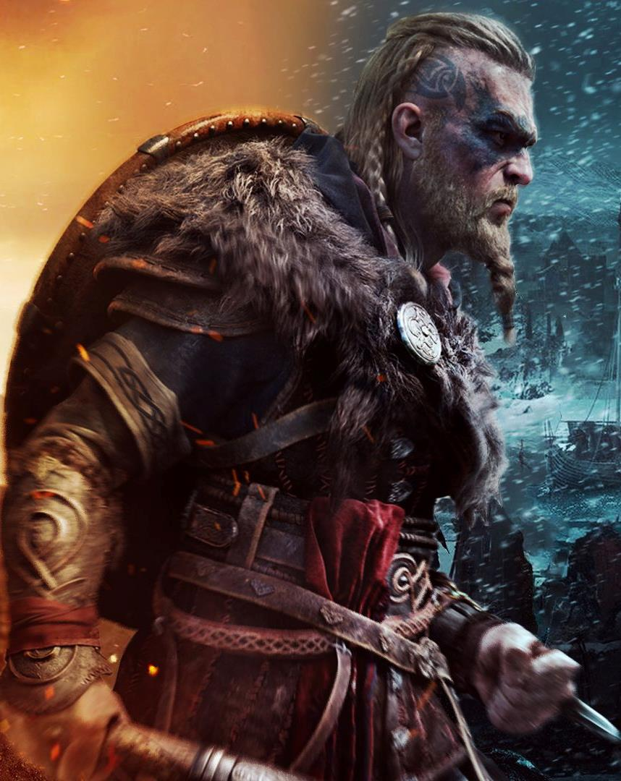
Player Profiling
Prof. Dr. Barbaros Bostan
barbaros.bostan@comm.bau.edu.tr

Slide 2
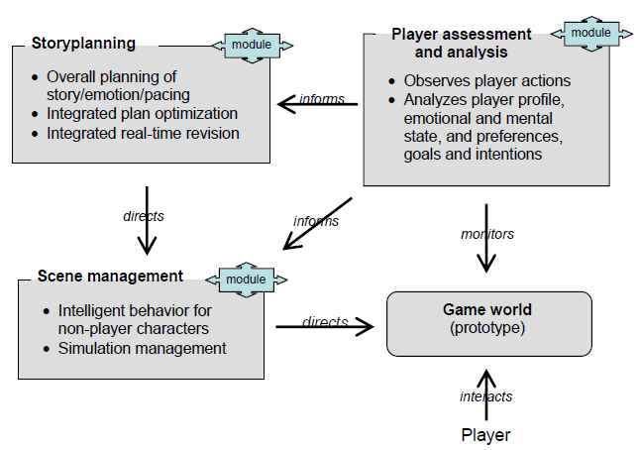
Automated Storytelling for Games

Slide 3
Player Profiling
Observing the player

Slide 4
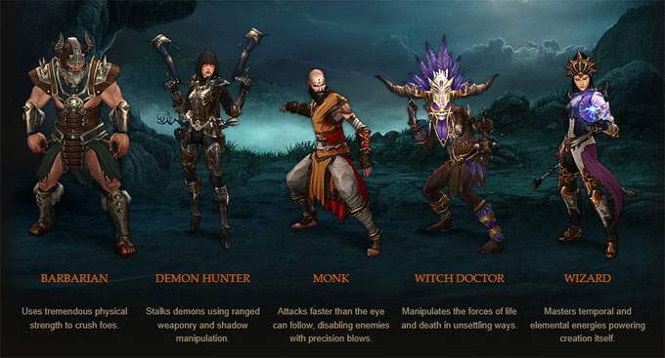
Profiling with Class?

Slide 5
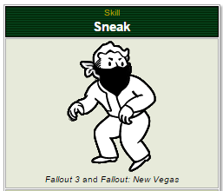
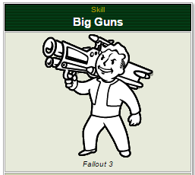
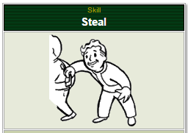
Profiling with Skills – Feats?

Slide 6
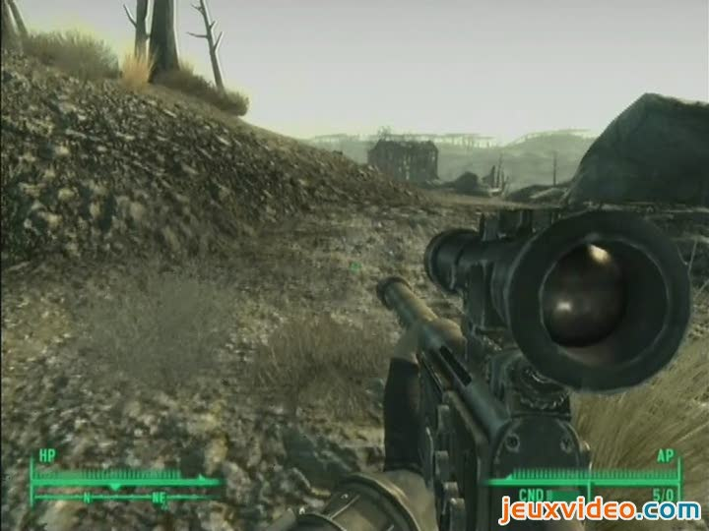
Profiling
Situation: Multiple enemies guarding a camp
Player Action: Sneak past the enemies
Profile?

Slide 7
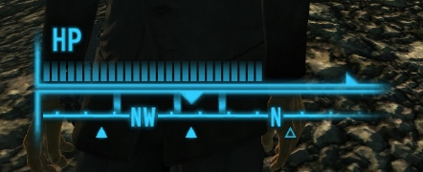
Profiling
Situation: Multiple enemies guarding a camp
Player Action: Sneak past the enemies
Needs: Harmavoidance (previously engaged multiple enemies, low on health and ammo)
Profile?

Slide 8
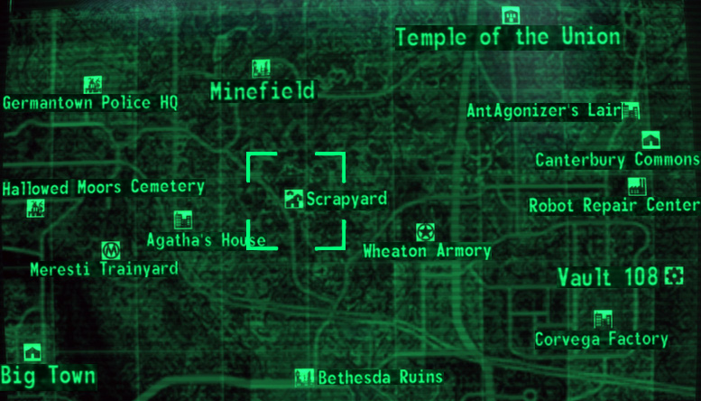
Profiling
Situation: Multiple enemies guarding a camp
Player Action: Sneak past the enemies
Goals: Reach a quest related place that is very near
Profile?

Slide 9
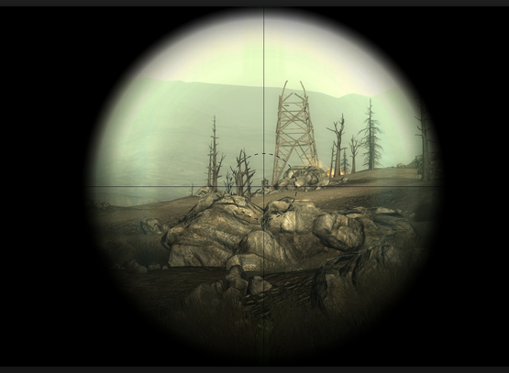
Profiling
Situation: Multiple enemies guarding a camp
Player Action: Sneak past the enemies
Further Action: Reaches a favorable position to use sniper rifle and engages the enemies from a distance
Profile?

Slide 10
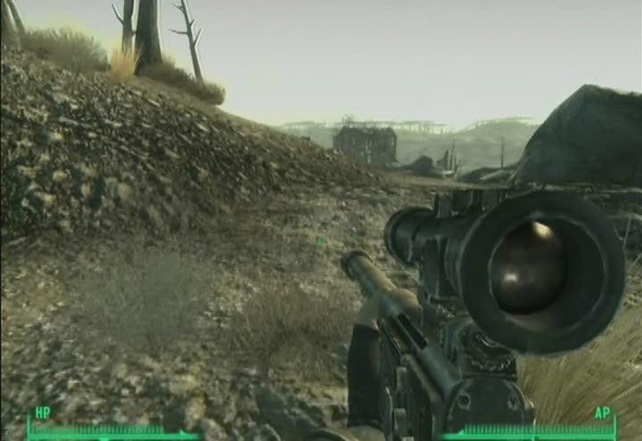
Profiling
Situation: Multiple enemies guarding a camp
Player Action: Sneak past the enemies
Situation: Player has died many times in the same camp before
Profile?

Slide 11
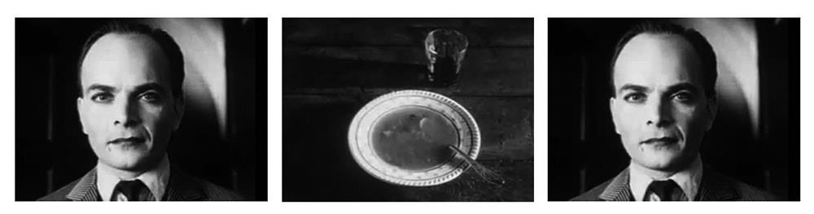
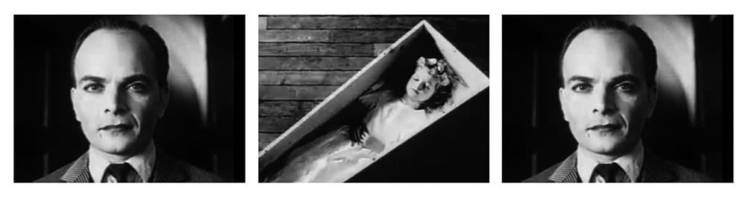
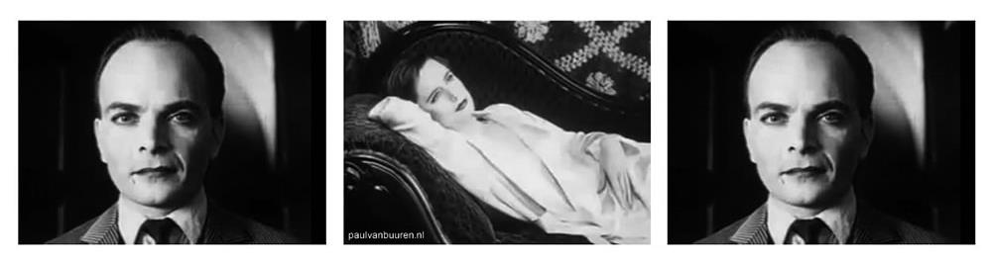

Slide 12
Profiling is context sensitive, it depends on the genre, it depends on the game, it even depends on the level/part of the game
Profiling is not an instantaneous act, gameplay sections should be analyzed for better results.

Slide 13
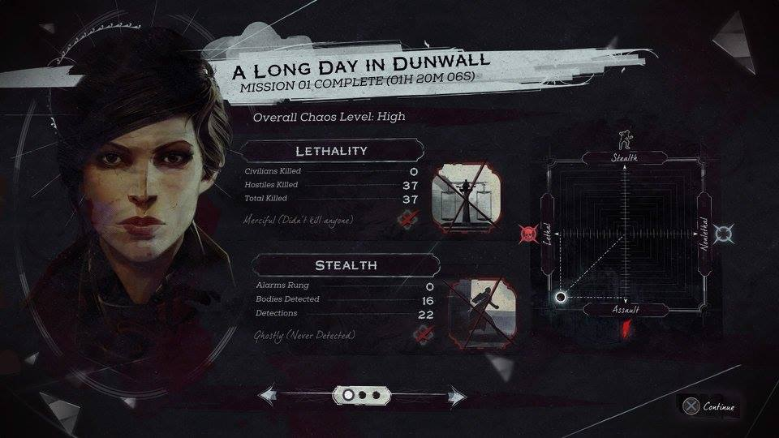

Slide 14
Player Profiles
Any profiles in literature?

Slide 15
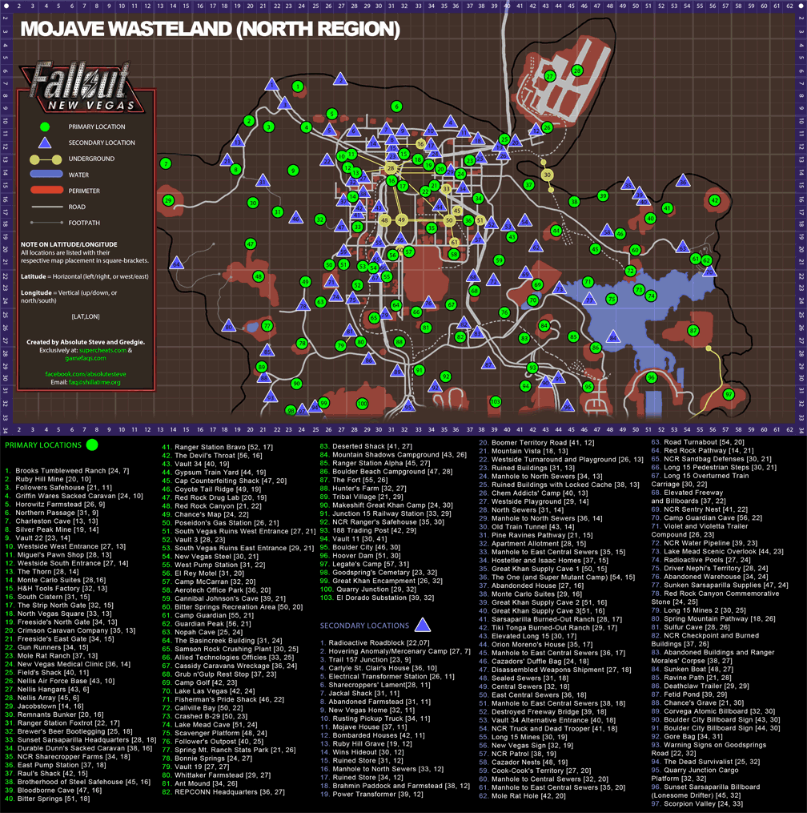
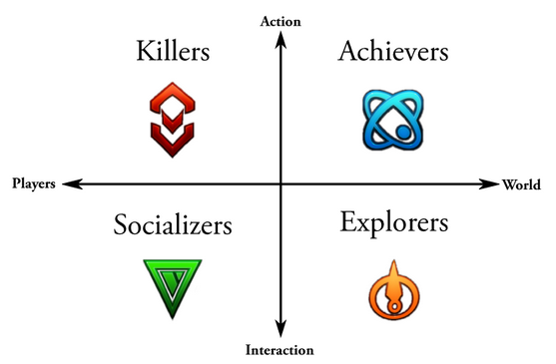
Bartle (2003)

Slide 16
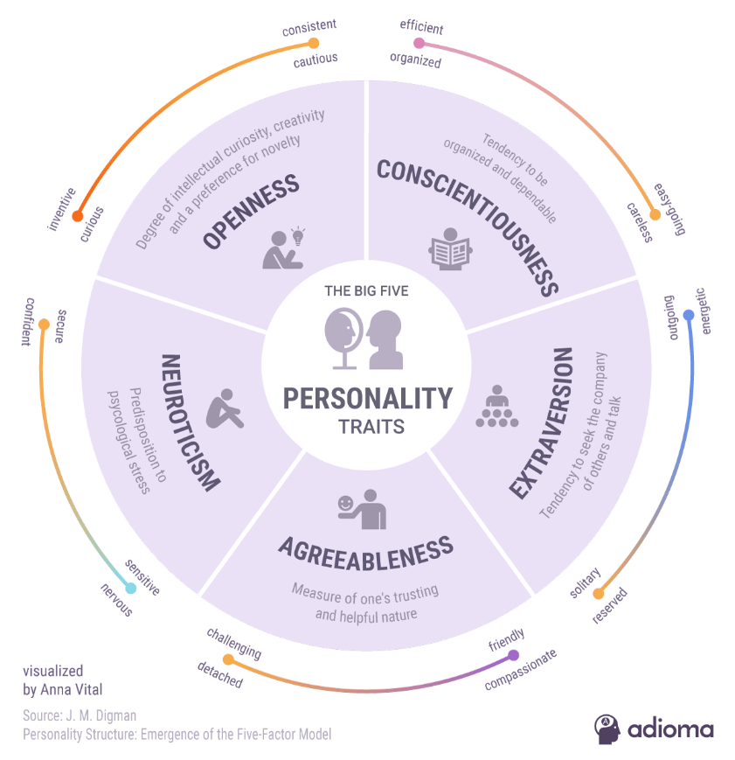
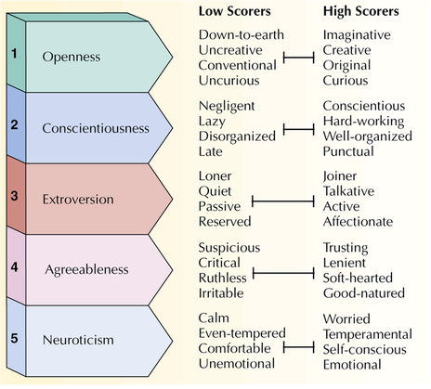
Big Five Personality Traits

Slide 17
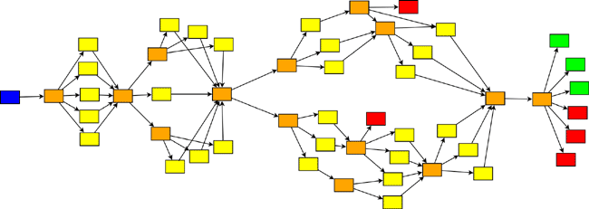
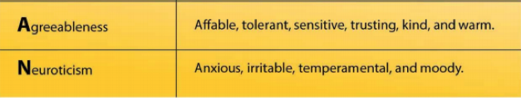
Story Branching / Profile

Slide 18
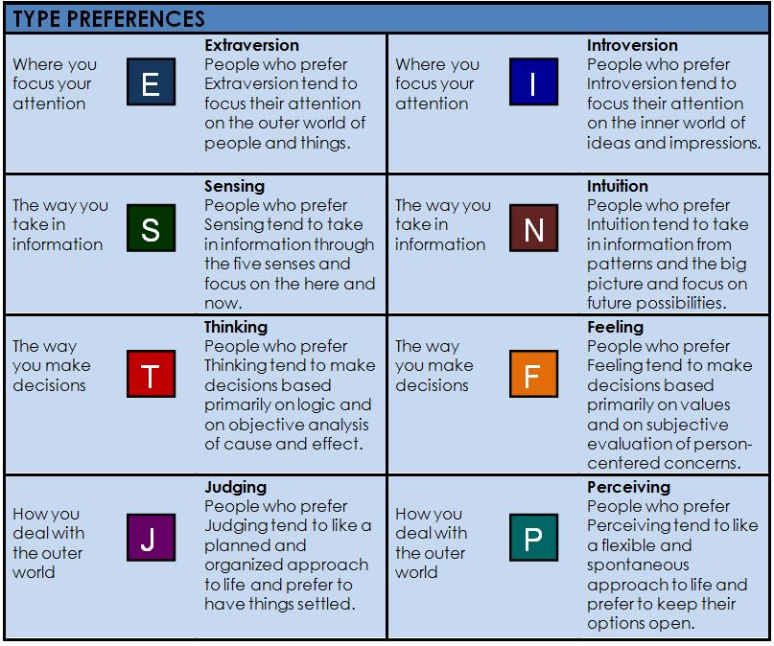
Myers-Briggs Personality Types

Slide 19
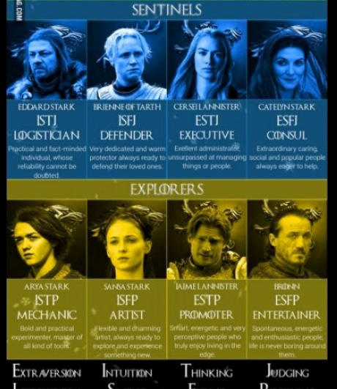
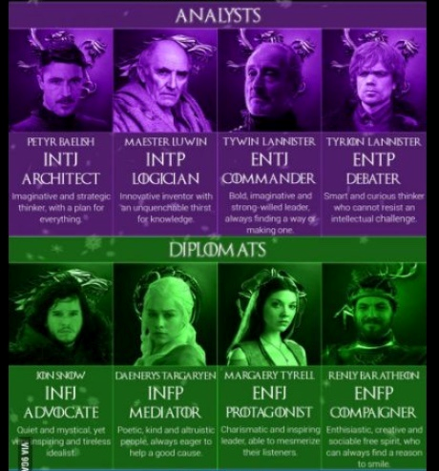
Myers-Briggs Personality Types

Slide 20
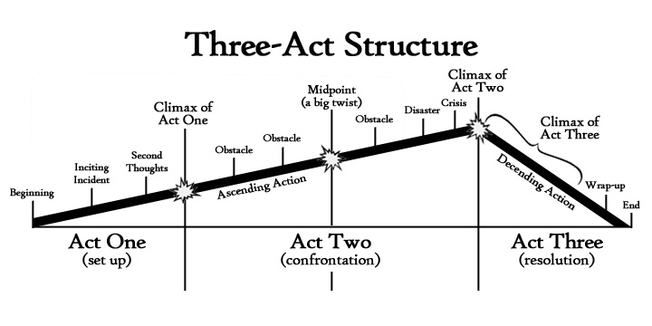
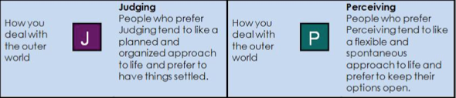
Story Pacing /Profile

Slide 21
Profiles in literature may not help you.
Psychological theories can not be applied easily to games/players.

Slide 22
Player Profiles
Profiling with metrics

Slide 23

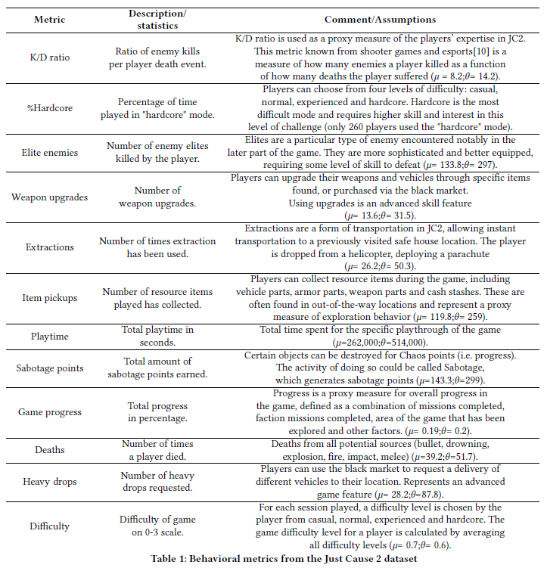
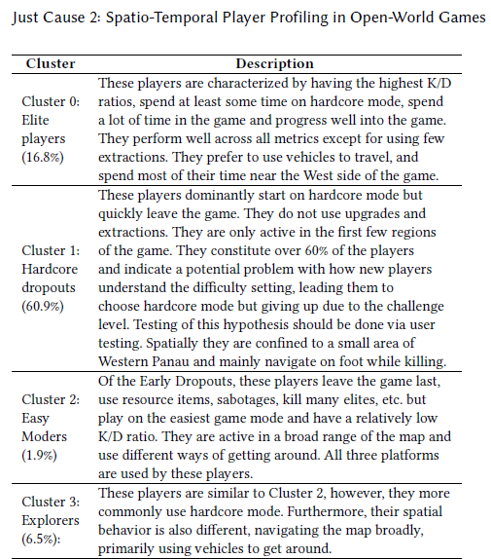
The Trails of Just Cause 2: Spatio-Temporal Player Profiling in Open-World Games

Slide 24
Player Profiles
Profile-Action Mapping

Slide 25
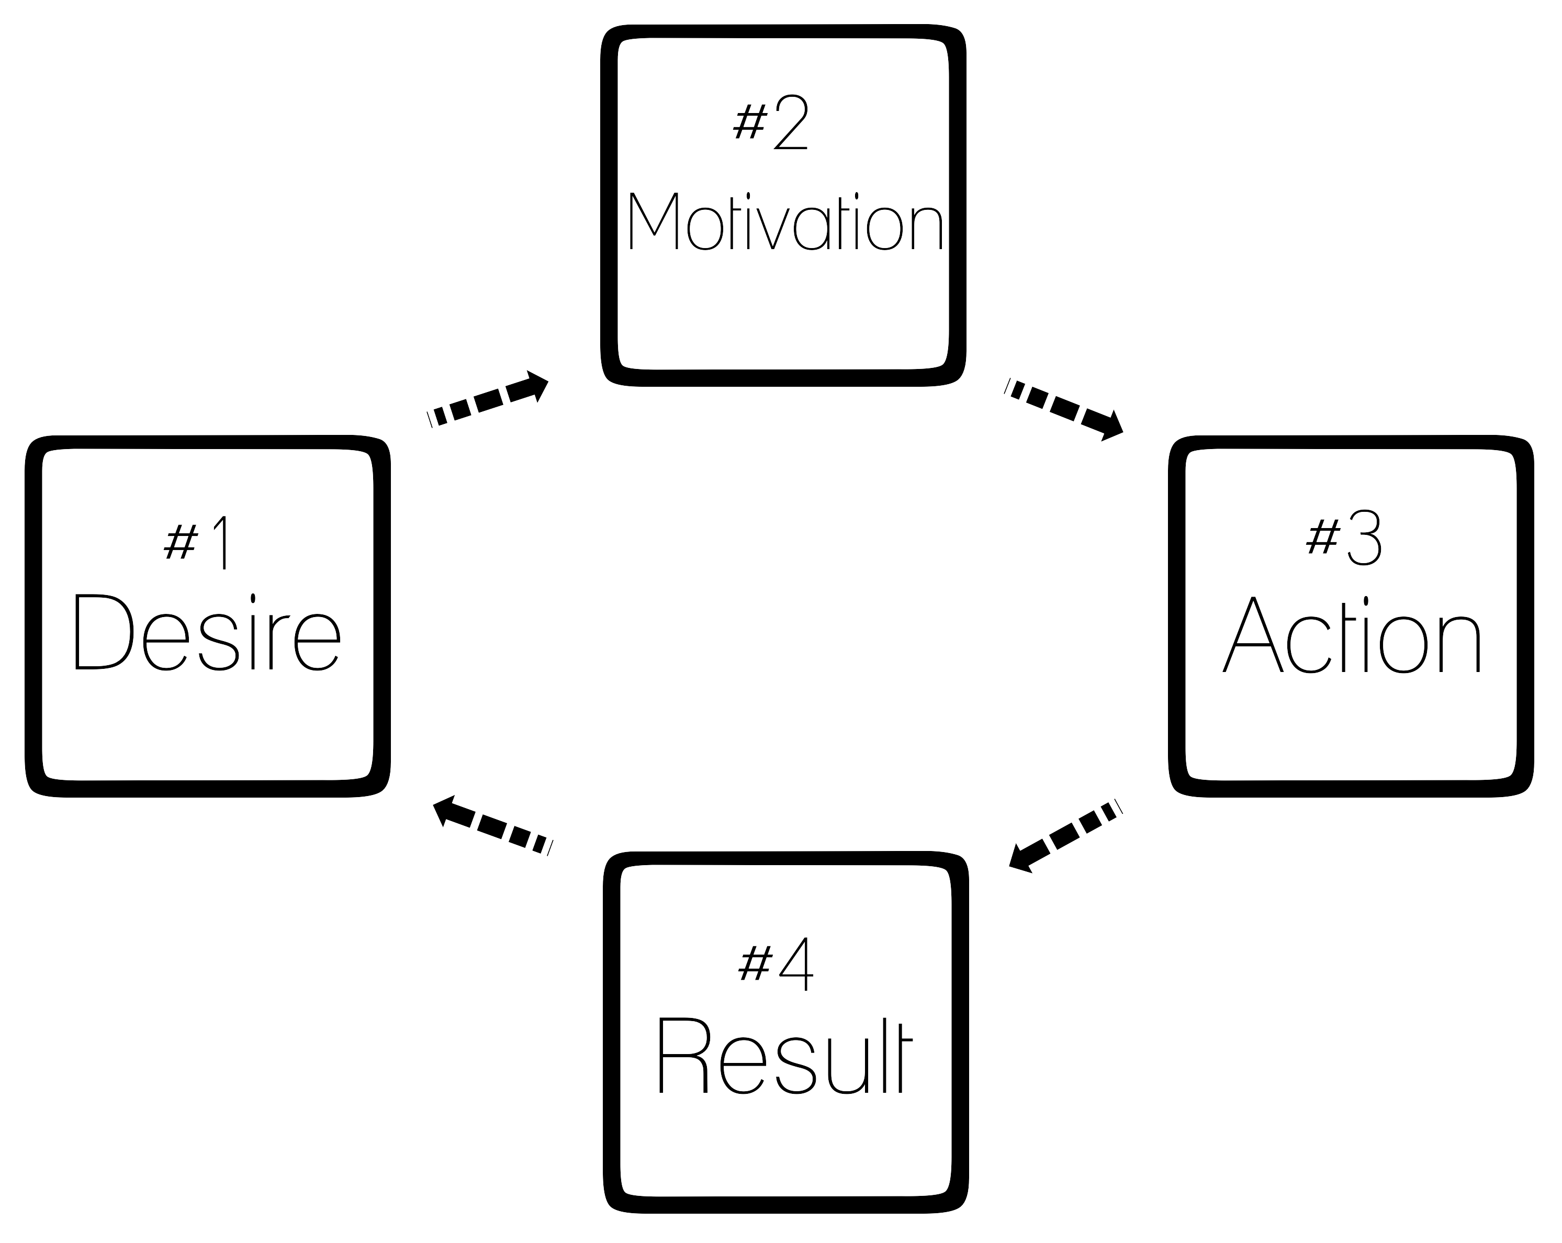
Motivation/Personality/Profile – Action Mapping?

Slide 26
Automated Storytelling for Games

Slide 27
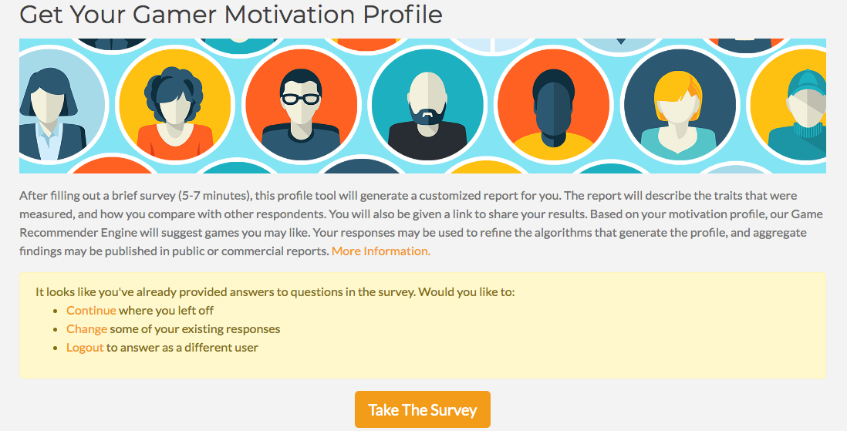
https://apps.quanticfoundry.com/surveys/start/gamerprofile/

Slide 28
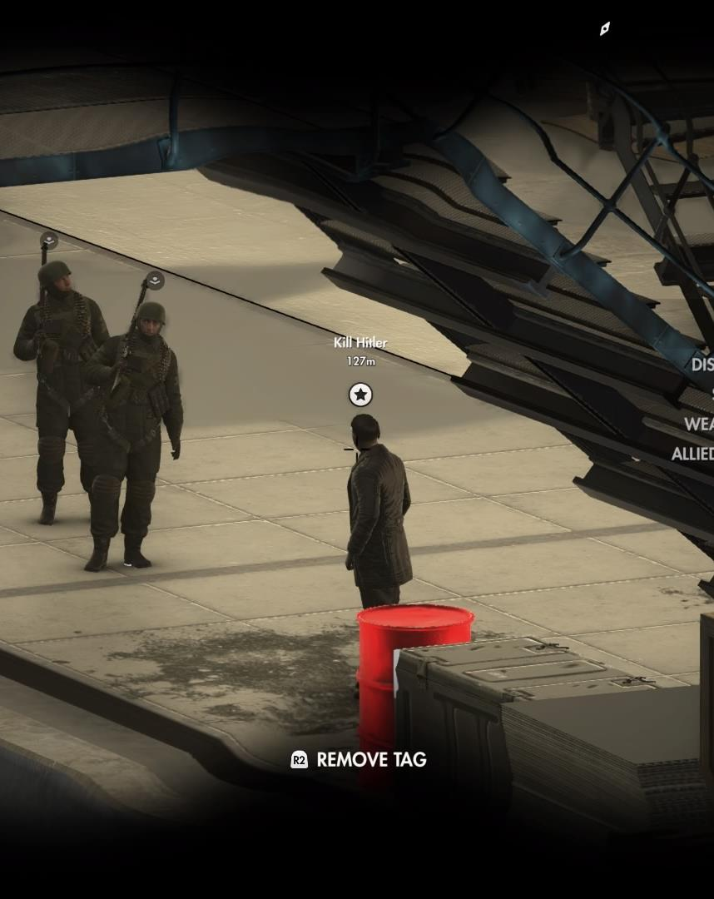

Gameplay/Profile Analysis

Slide 29
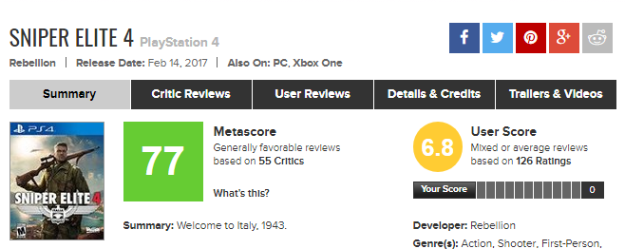
Game genre and related games/Technological context
Sniper Elite 4 is a third-person tactical shooter stealth video game developed by Rebellion Developments. The sequel to Sniper Elite III, the game was released for Microsoft Windows, PlayStation 4 and Xbox One on 14 February 2017.
Innovations:
X-Ray Kill Cam
Better AI
Bigger and better maps
Collaborative and competitive missions
Competitors
Tom Clancy's Ghost Recon Wildlands

Slide 30
Single Player

Slide 31
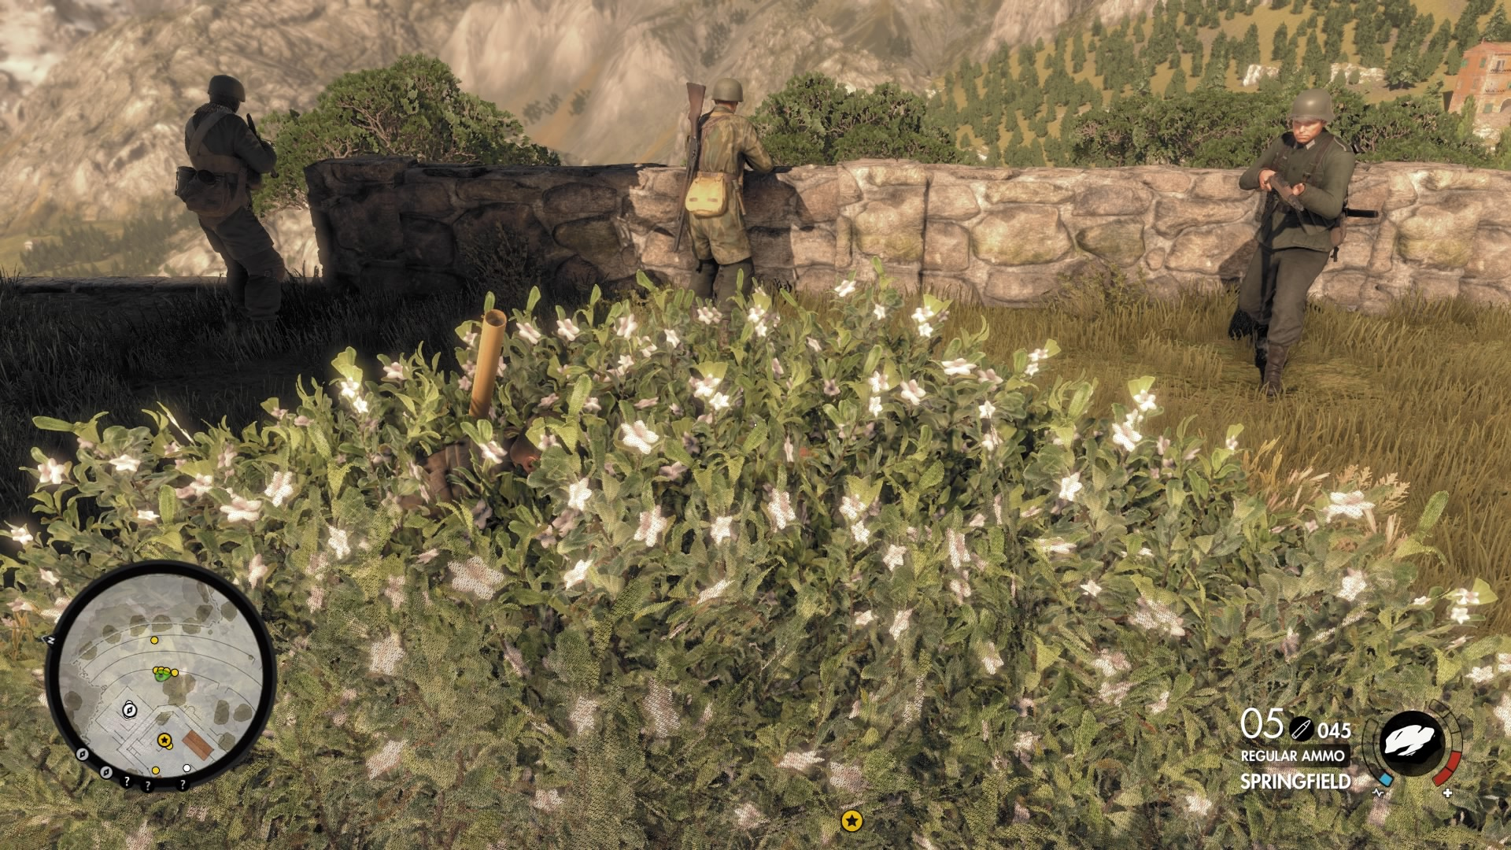

Slide 32
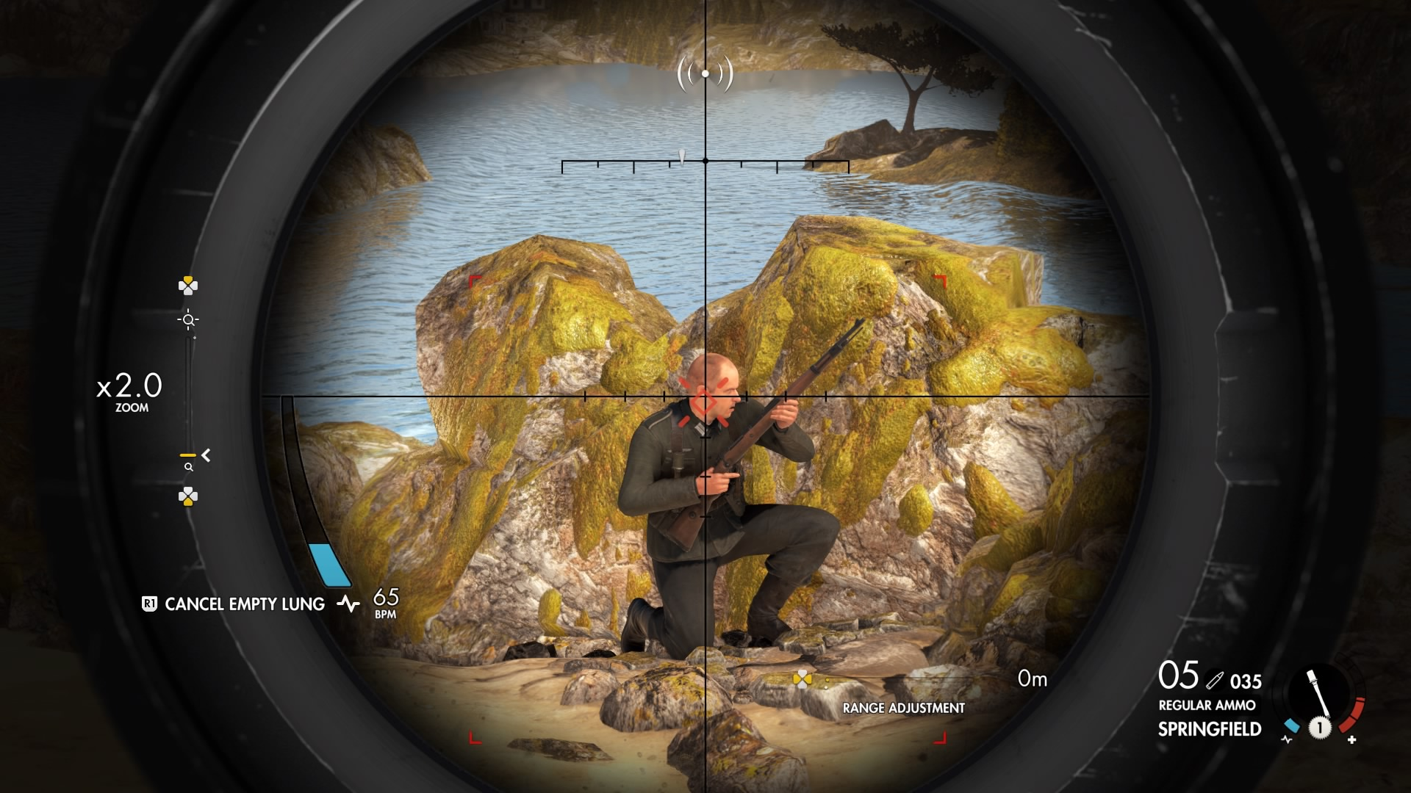

Slide 33
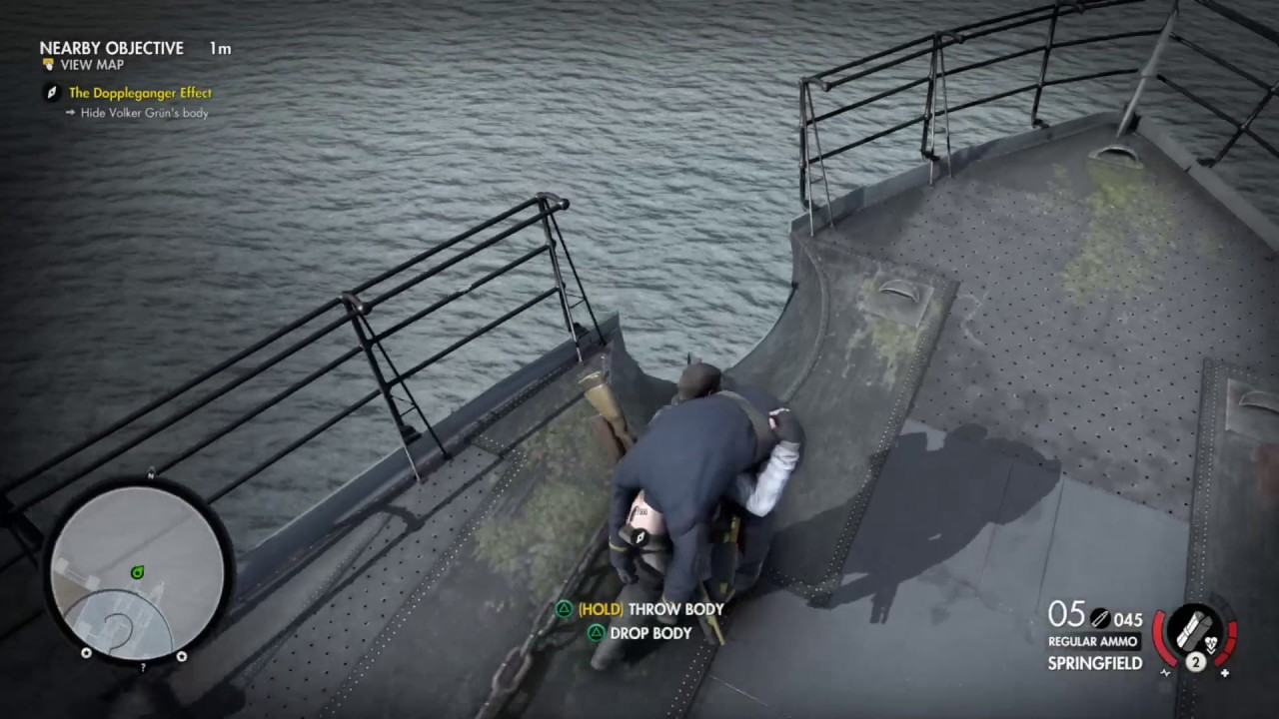

Slide 34
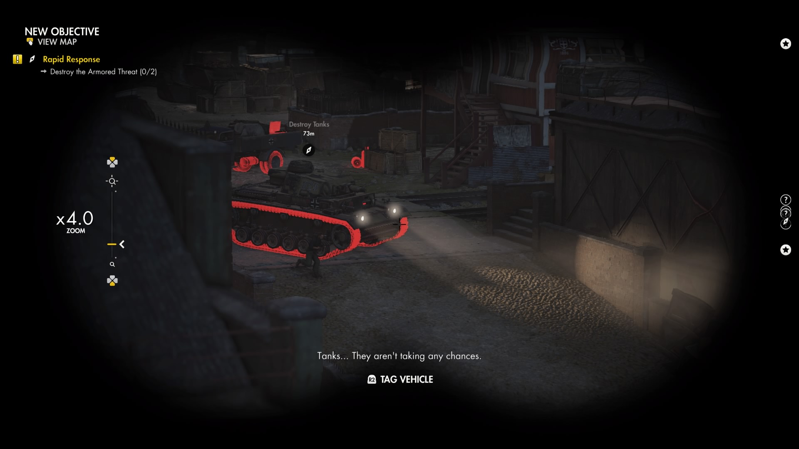

Slide 35
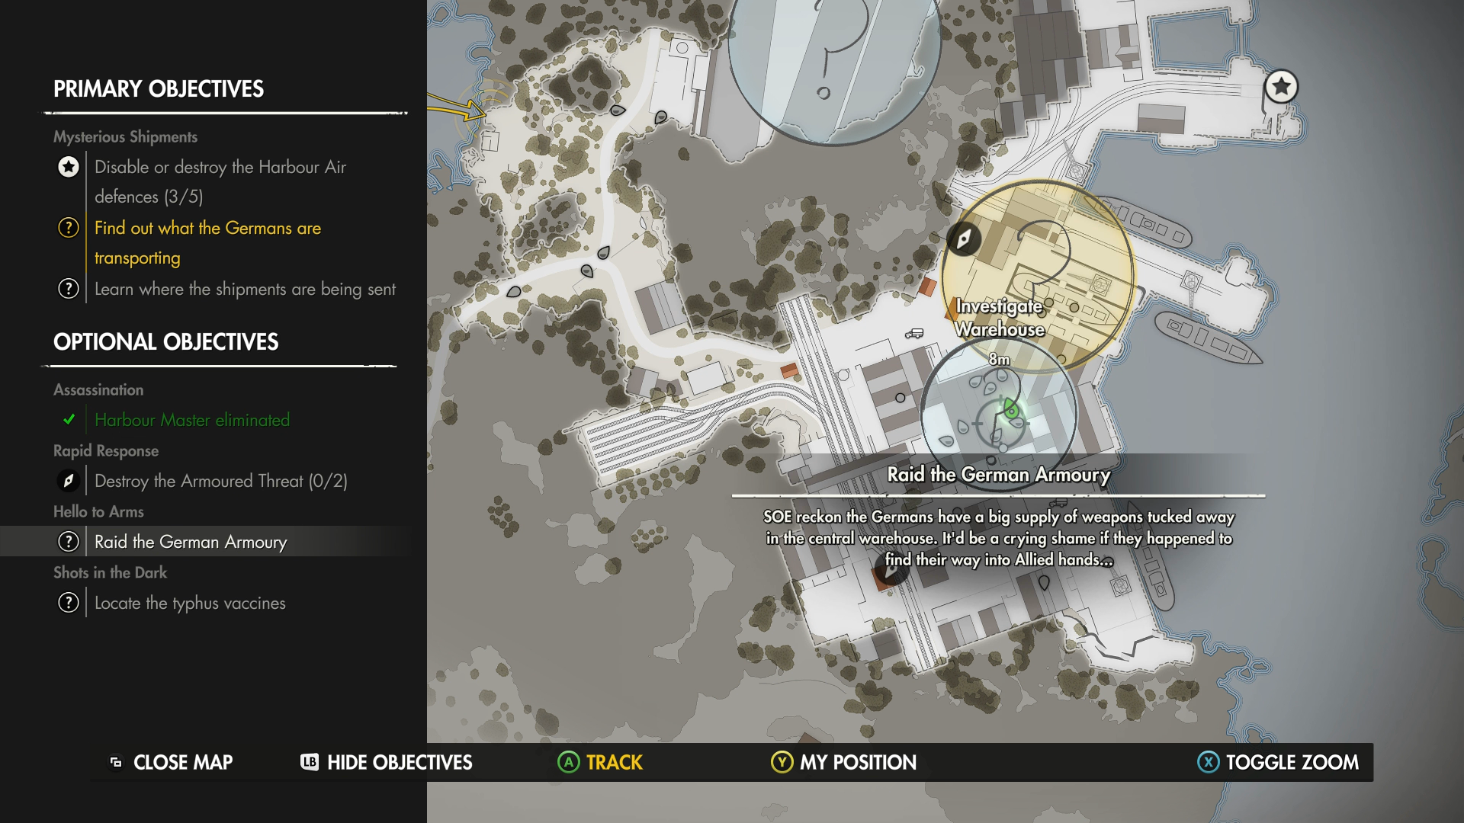

Slide 37
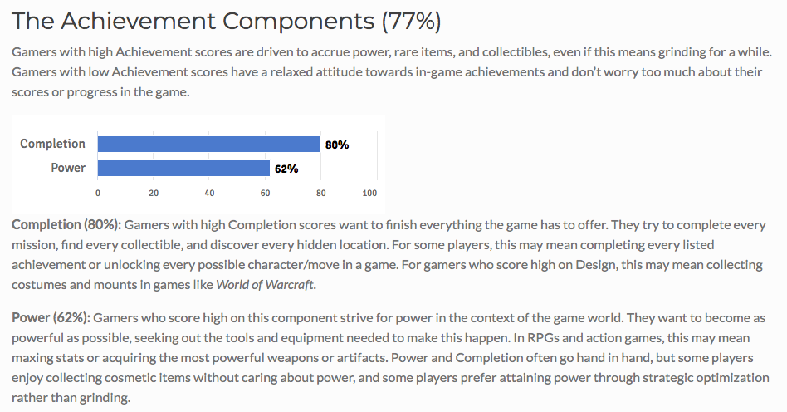

Slide 38
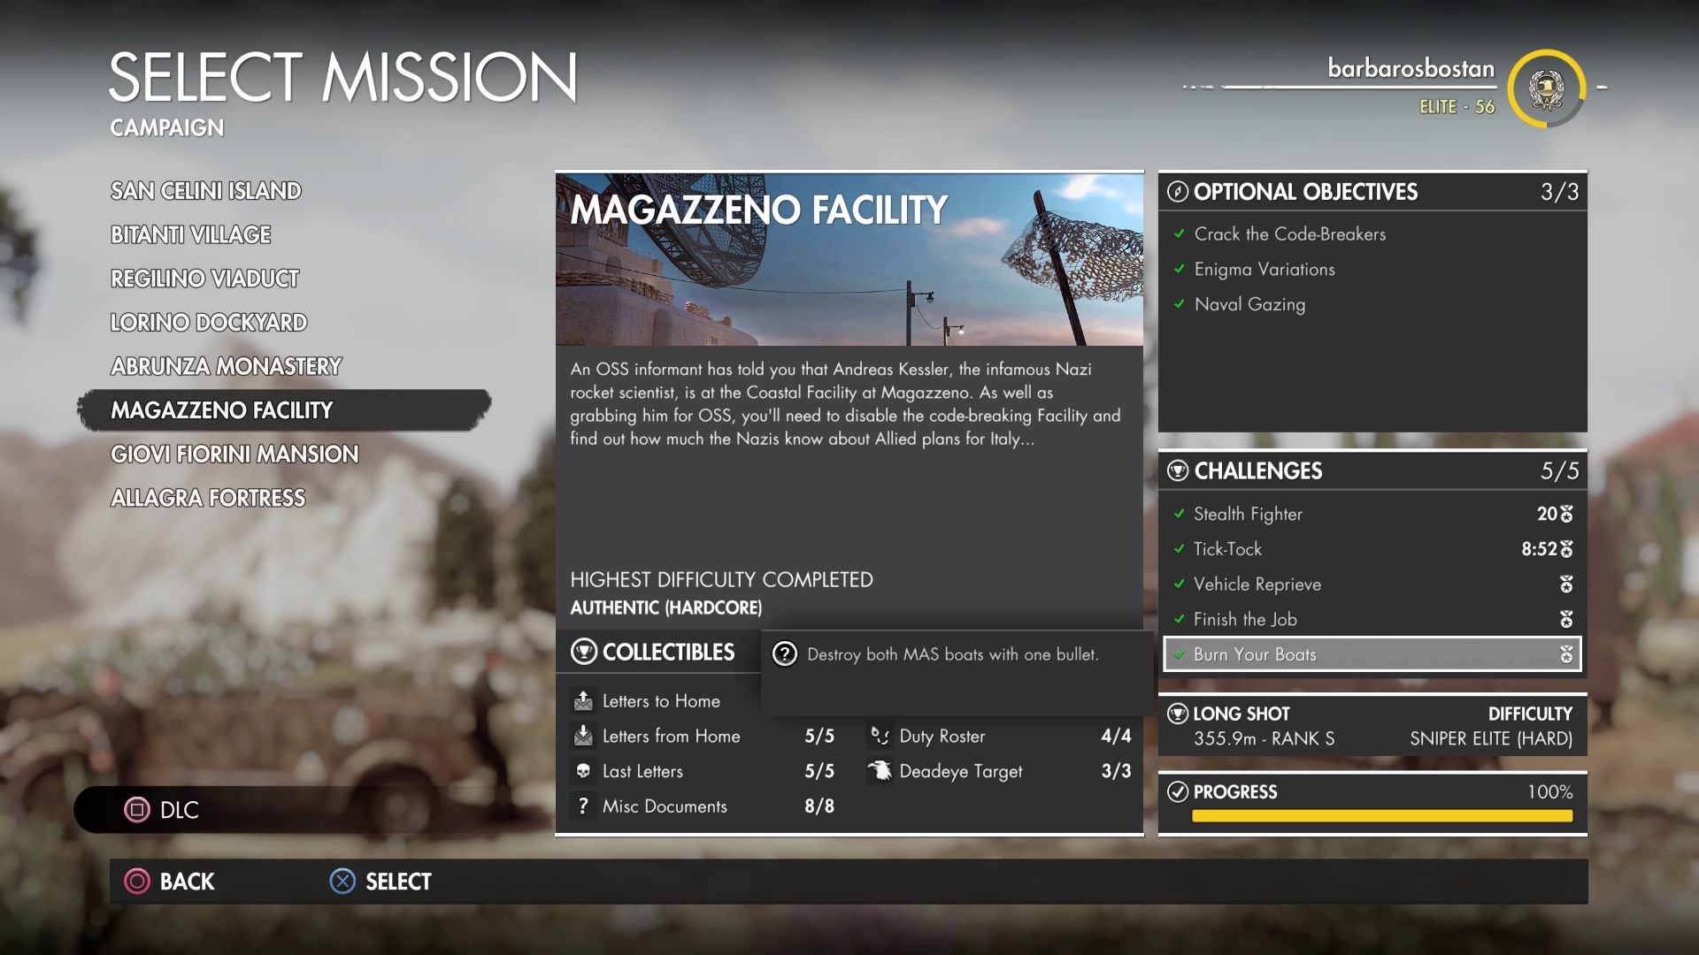

Slide 39
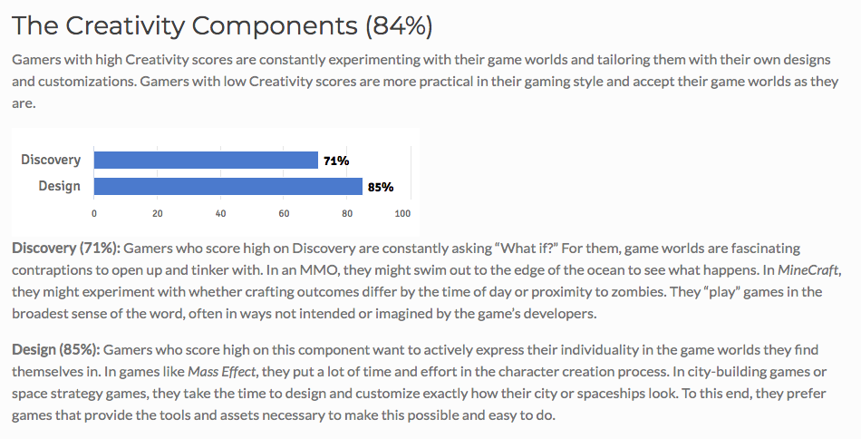

Slide 40
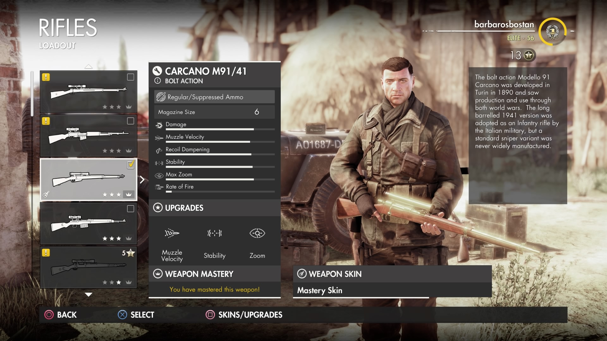

Slide 41
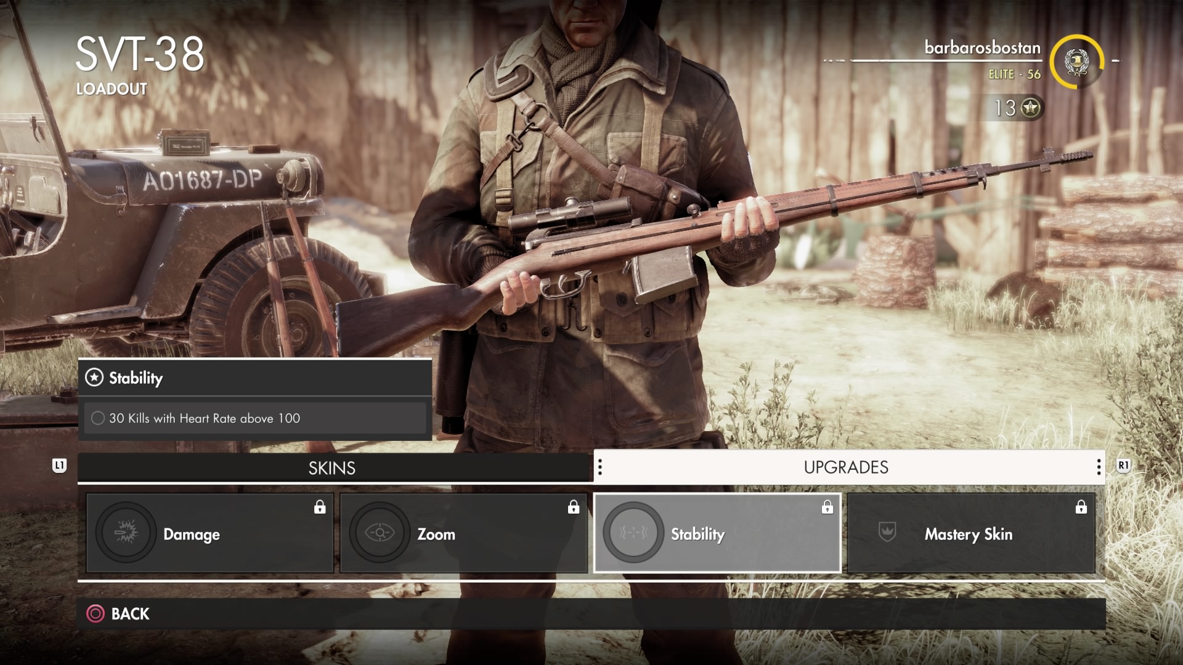

Slide 42
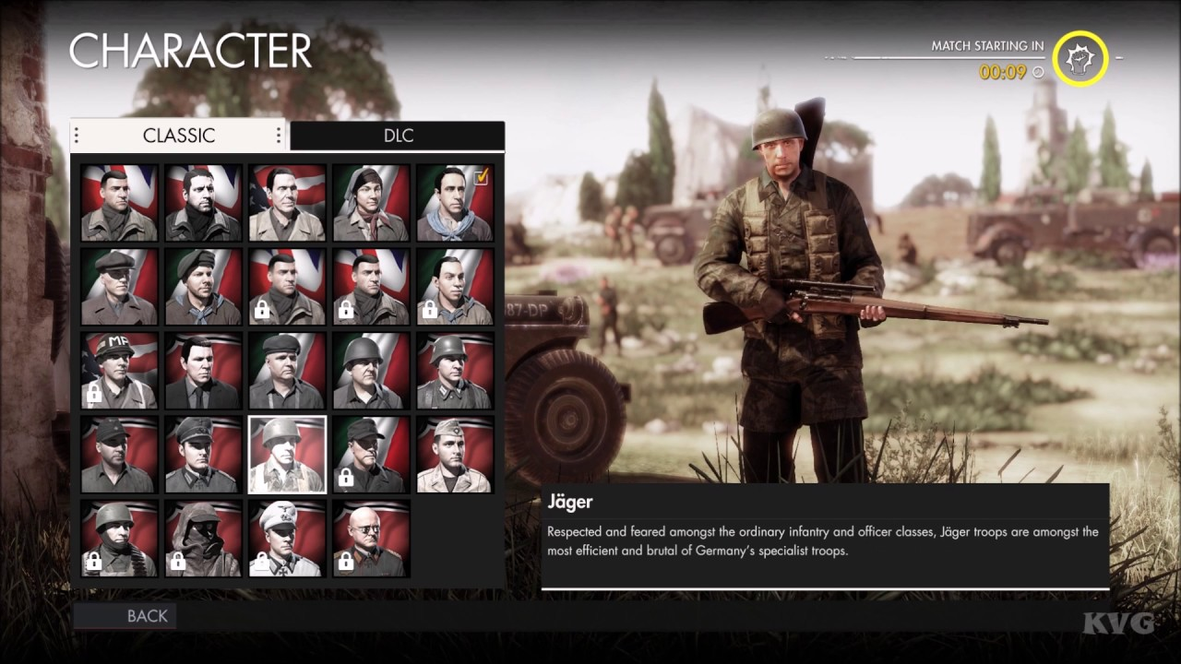

Slide 43
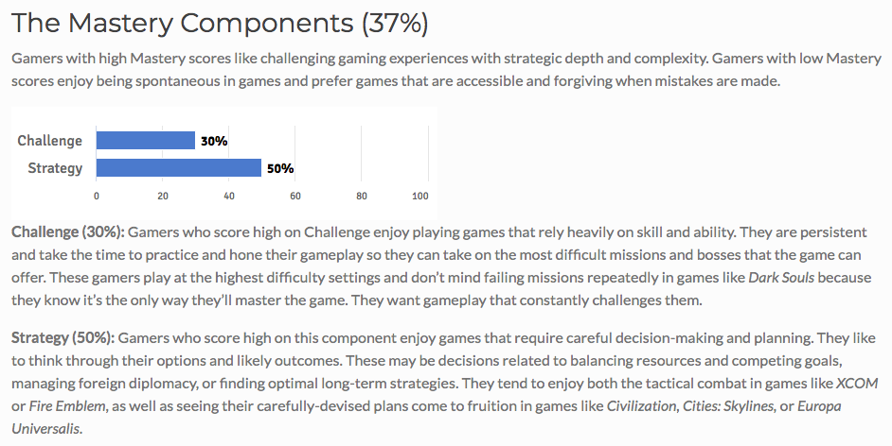

Slide 44
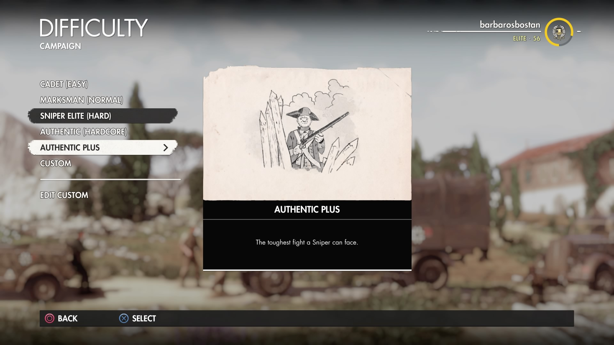

Slide 45
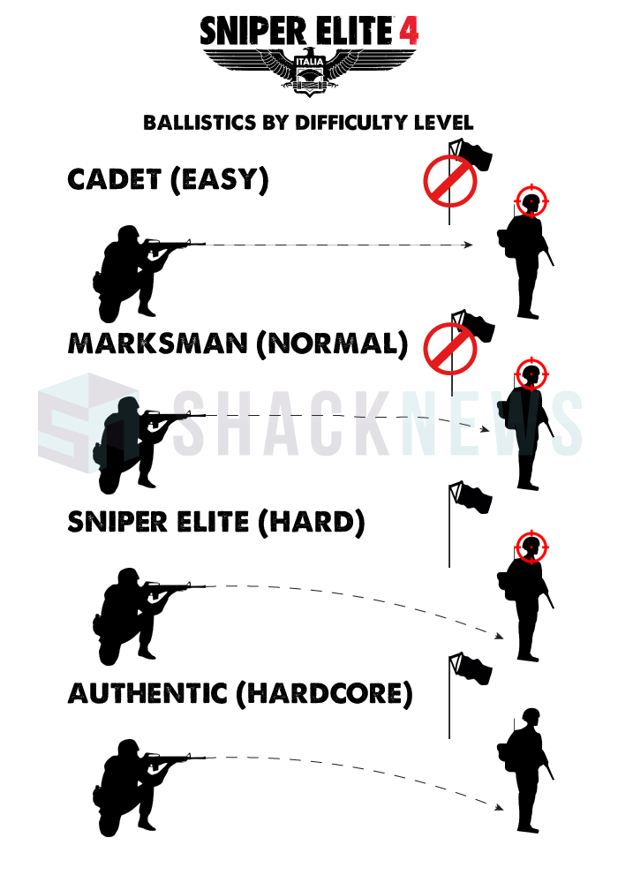
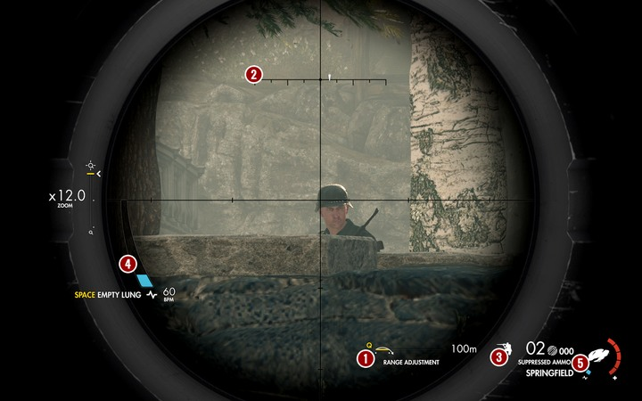
Sniper Elite 4

Slide 46
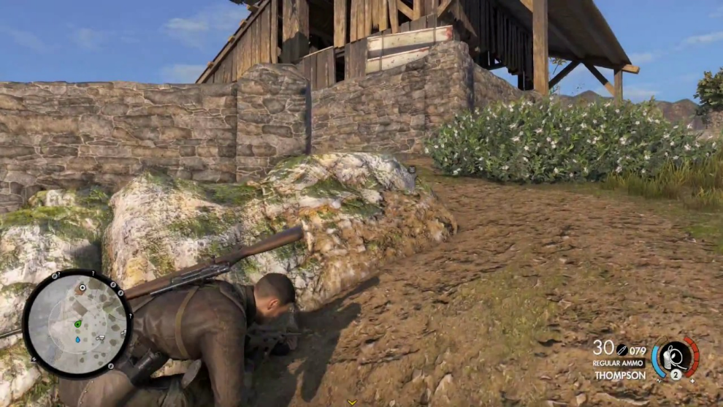
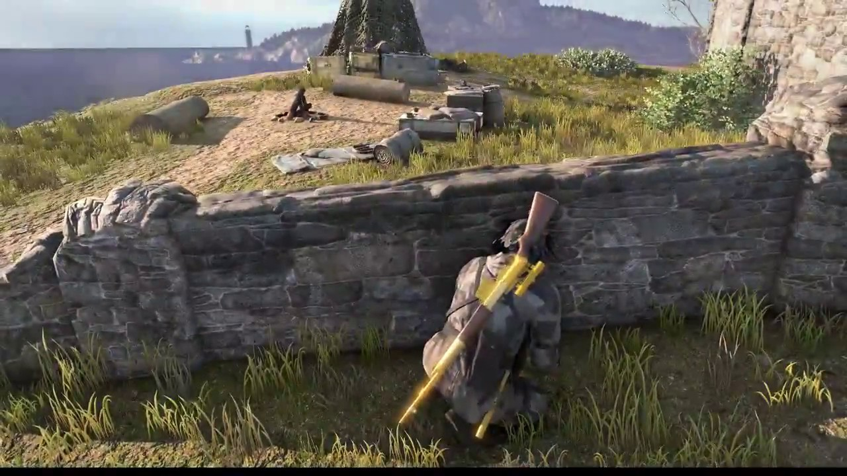

Slide 48
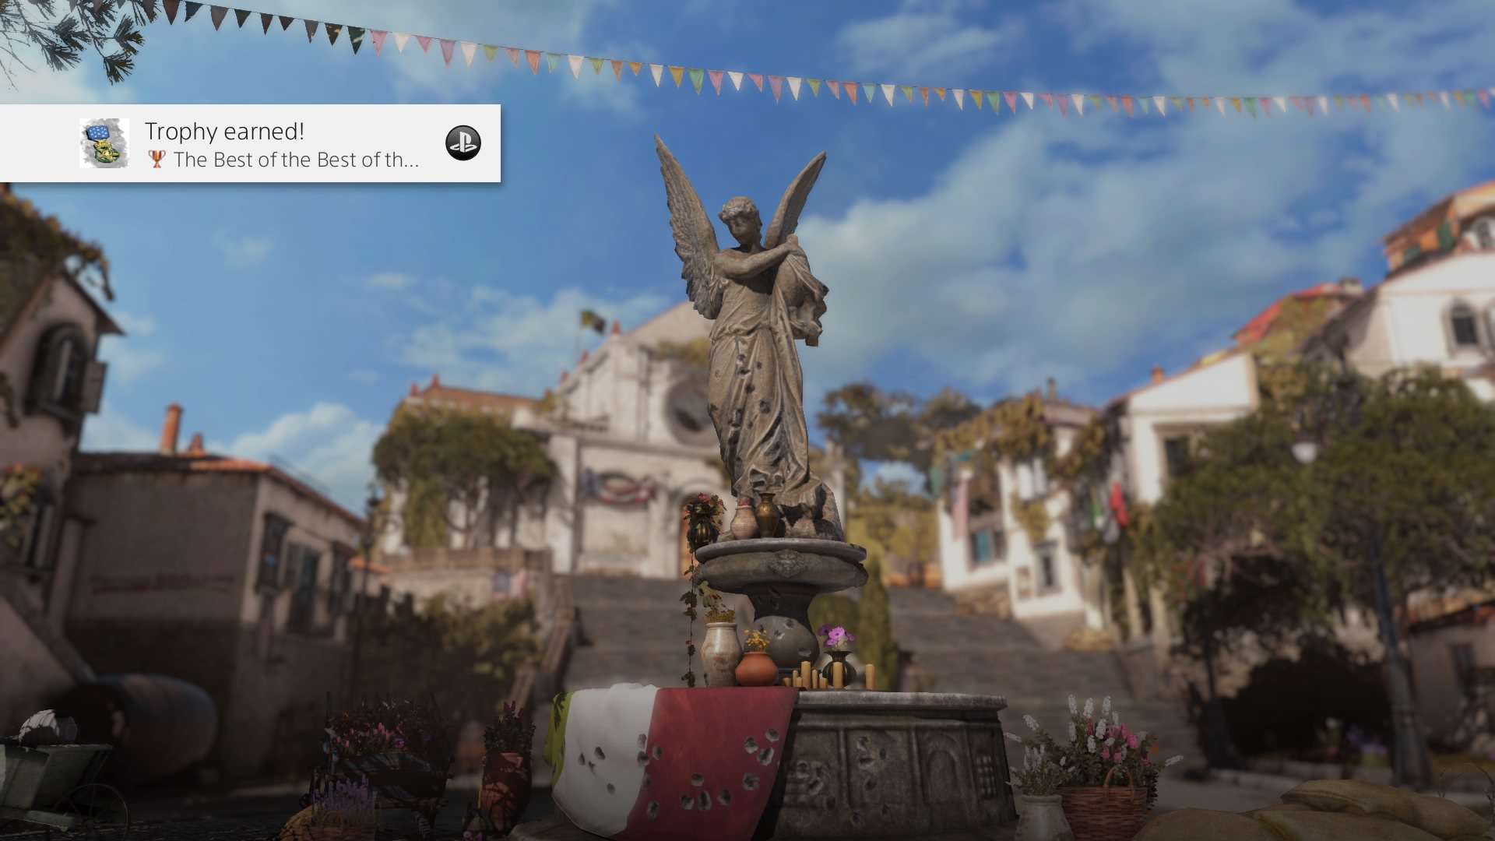


Slide 49
Cooperative

Slide 50


Slide 51


Slide 52


Slide 53


Slide 54
Multiplayer

Slide 56


Slide 58

Sniper Elite 4

Slide 60


Slide 62


Slide 63


Slide 64

Sniper Elite 4

Slide 65

Sniper Elite 4

Slide 66

Sniper Elite 4

Slide 68
Sniper Elite 4

Slide 69

Sniper Elite 4

Slide 70
Player Profiling
Prof. Dr. Barbaros Bostan
barbaros.bostan@comm.bau.edu.tr

Slide 71
Summary
Player Profiling Problems
Psychological Profiles
Profiling with Metrics
Gamer Motivation Profile & Player Profiling

